Slide 1
The Data Link Layer

Slide 2
Introduction
Data link layer performs the most reliable node to node delivery of data. It forms frames from the packets that are received from network layer and gives it to physical layer.
It also synchronizes the information which is to be transmitted over the data.
Error detection bits are used by the data link layer. It also corrects the errors.
Error controlling is easily done. The encoded data are then passed to physical layer.
Outgoing messages are assembled into frames. Then the system waits for the acknowledgements to be received after the transmission. It is reliable to send message.

Slide 3
Task of data link layer
The main task of the data link layer is to transform a raw transmission facility into a line that appears free of undetected transmission errors to the network layer.
It accomplishes this task by having the sender break up the input data into data frames(typically a few hundred or few thousand bytes) and transmit the frames sequentially.
If the service is reliable, the receiver confirms correct receipt of each frame by send back an acknowledgement frame.
Notes:
https://www.studytonight.com/computer-networks/osi-model-datalink-layer

Slide 4
Functions of Data Link Layer
Framing: Frames are the streams of bits received from the network layer into manageable data units. This division of stream of bits is done by Data Link Layer.
Physical Addressing: The Data Link layer adds a header to the frame in order to define physical address of the sender or receiver of the frame, if the frames are to be distributed to different systems on the network.
Flow Control: A flow control mechanism to avoid a fast transmitter from running a slow receiver by buffering the extra bit is provided by flow control. This prevents traffic jam at the receiver side.

Slide 5
Cont…
Error Control: Error control is achieved by adding a trailer at the end of the frame. Duplication of frames are also prevented by using this mechanism. Data Link Layers adds mechanism to prevent duplication of frames.
Access Control: Protocols of this layer determine which of the devices has control over the link at any given time, when two or more devices are connected to the same link.

Slide 6
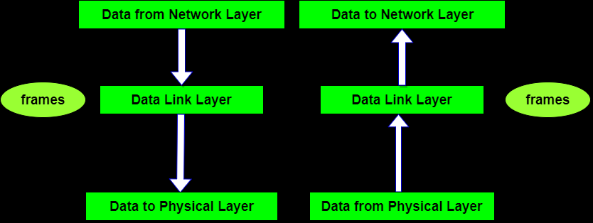
Cont…

Slide 7
Data Link Layer Design Issues
Services Provided to the Network Layer
Framing
Error Control
Flow Control

Slide 8
Data Link Layer Issues
Functions of the Data Link Layer
  Provide service interface to the network layer
  Dealing with transmission errors
  Regulating data flow: Slow receivers not swamped by fast senders
To accomplish these goals, the data link layer encapsulates the packets into frames.

Slide 9
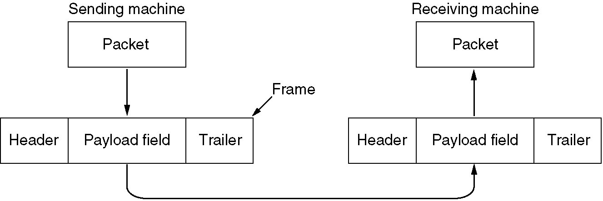
Functions of the Data Link Layer
Relationship between packets and frames

Slide 10
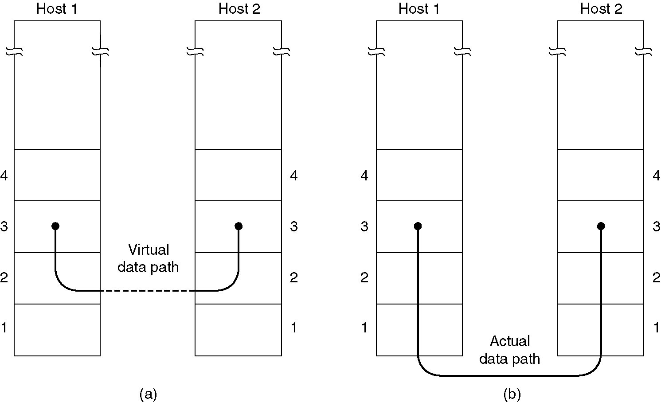
Services Provided to Network Layer
(a) Virtual communication (model used).
(b) Actual communication.

Slide 11
Services to the Network Layer
Three possible services offered by the data link layer:
  Unacknowledged connectionless service: appropriate for channel with low error rate, real-time traffic, LAN
  Acknowledged connectionless service: useful over unreliable channel such as wireless systems
  Acknowledged connection-oriented service: used in routing

Slide 12
Framing
To detect or correct errors in the raw bit stream from the physical layer, the data link layer breaks the bit stream up into discrete frames and computes the checksum for each frame.
Four methods can be used to mark the start and end of each frame:
  Character count/Byte count
  Flag bytes with byte/character stuffing
  Starting and ending flags, with bit stuffing
  Physical layer coding violations

Slide 13
Framing
Byte Count/ Character Count
  To specify the number of bytes/characters in the frame
  How many bytes follow and hence where the end of the frame
Flag bytes with byte/character stuffing
  Each frame start and end with special bytes – flag byte
  If the flag byte occurs in the frame, stuff an extra escape byte (ESC).
  Used in PPP (Point to Point Protocol)

Slide 14
Framing
Starting and ending flags, with bit stuffing
  Each frame begins and ends with a special bit pattern 0111110 which is called flag byte. whenever the sender sees 5 consecutive 1s, it stuffs a 0. so, from the pattern we get 011111010.
Physical layer coding violations
  Only applicable to networks in which the encoding on the physical medium contains some redundancy.
  For example, a 1 bit is a high-low pair and a 0 bit is a low-high pair. High-high and low-low are used for delimiter.

Slide 15
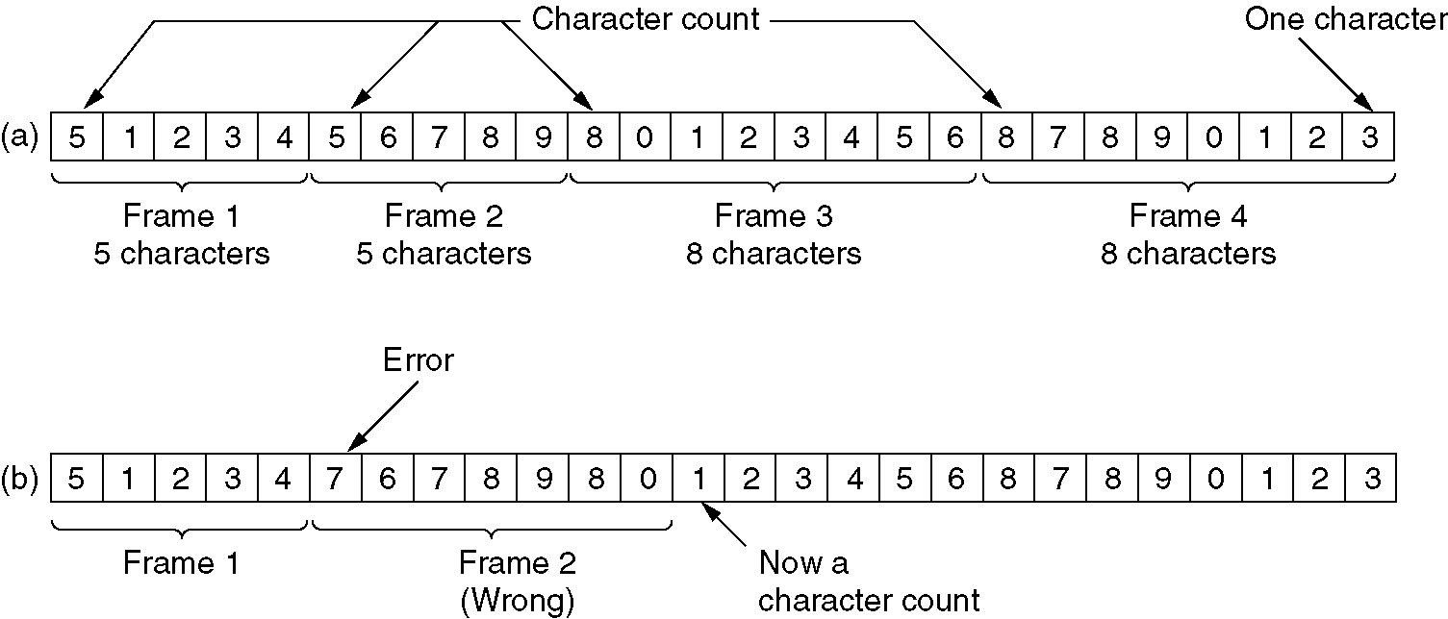
Framing (Byte Count/ Character Count)
A character stream. (a) Without errors. (b) With one error
Disadvantage: The count may be garbled. Rarely used.

Slide 16
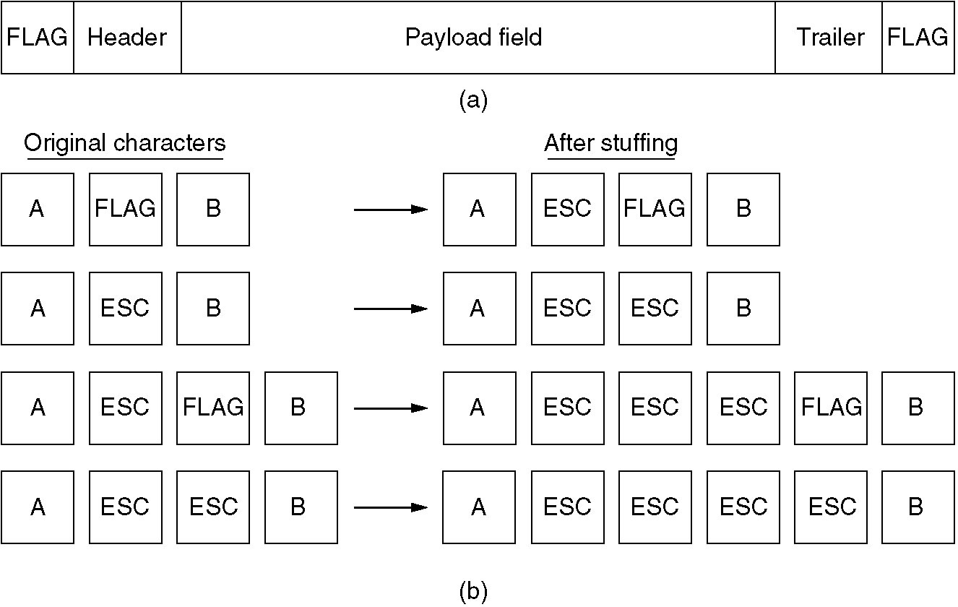
Framing (Flag bytes with byte/character stuffing)
(a) A frame delimited by flag bytes.
(b) Four examples of byte sequences before and after stuffing.

Slide 17
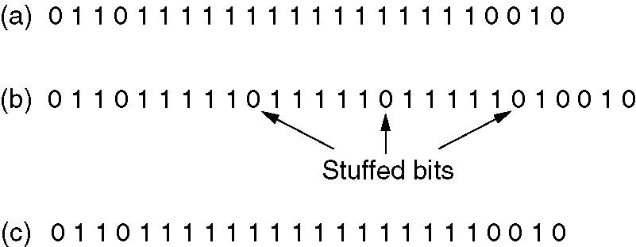
Framing (Starting and ending flags, with bit stuffing)
Bit stuffing
(a) The original data.
(b) The data as they appear on the line.
(c) The data as they are stored in receiver’s memory after destuffing.

Slide 18
Error and Flow Control
Error Control
  Detect and/or correct errors
  Ensure that all frame are eventually delivered in order use acknowledgement, timer, and sequence number
Flow Control
  Slow down the sender when the data is coming too fast for the receiver
  Two approaches:
    Feedback-based flow control – the receiver sends back permission to the sender.
    Rate-based flow control – built-in mechanism that limits senders’ rate. Rarely used in the data link layer.

Slide 19
Error Detection and Correction
Error-correcting codes/forward error correction
  include enough redundant information to enable the receiver to deduce the correct transmitted data.
  Used in unreliable channel such as wireless links
Error-detecting codes
  include only enough redundancy to allow the receiver to request a retransmission.
  Used in reliable channel such as fiber

Slide 20
Error Correction Codes
Four different error-correcting codes:
  Hamming Codes
  Binary Convolutional Codes
  Reed-Solomon Codes
  Low-Density Parity Check Codes

Slide 21
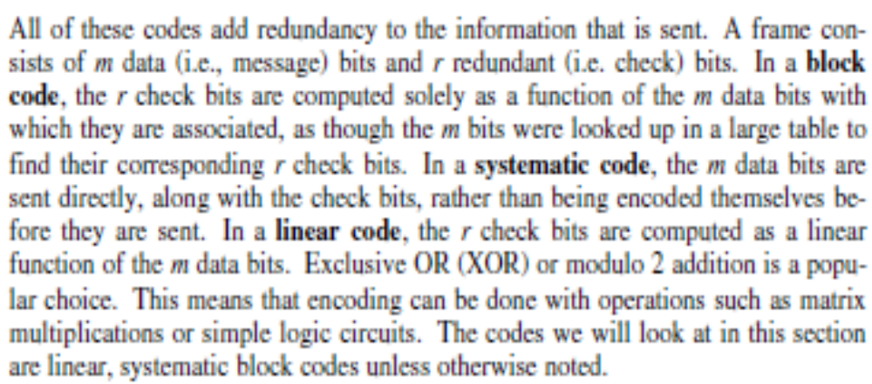

Slide 22
Error Correction Codes
Let n-bit codeword = m-bit data + r-bit check
The number of bit positions in which two codewords differ is called the Hamming distance.
Example: Hamming distance is 3.
10001001
xor 10110001
00111000 ←3 bit difference
If two codewords are a Hamming distance d apart, it will require d single-bit errors to convert one into the other.

Slide 23
Hamming Codes
Bits are numbered from the left . Checkbits are bits numbered powers of 2. {1,2,4,8,...}. Each checkbit forces the parity of some collection of bits, including itself, to be even or odd.
To see which check bits the data in position k contributes to, write k as a sum of powers of 2.
Data bits | 3 | 5 | 6 | 7 | 9 | 10 | 11
Check bits | 1 + 2 | 1 + 4 | 2 + 4 | 1 + 2 + 4 | 1 + 8 | 2 + 8 | 1 + 2 + 8
Check bits | 1 | 2 | 4 | 8
Data bits | 3 + 5 + 7 + 9 + 11 | 3 + 6 + 7 + 10 + 11 | 5 + 6 + 7 | 9 + 10 + 11

Slide 24
Error Detecting codes
Parity
Checksums
Cyclic Redundancy Check

Slide 25
Cyclic Redundancy Check
A major goal in designing error detection algorithms is to maximize the probability of detecting errors using only a small number of redundant bits.
In general, correcting is more expensive than detecting and re-transmitting.
Add k bits of redundant data to an n-bit message
  want to use k << n to detect errors
  e.g., k = 32 and n = 12,000 (1500 bytes)
Represent n-bit message as n-1 degree polynomial
  e.g., MSG=10011010 as M(x) = x⁷ + x⁴ + x³ + x¹
Let k be the degree of some divisor polynomial
  e.g., G(x) = x³ + x² + 1

Slide 26
Elementary Data Link Protocols
An Unrestricted Simplex Protocol
  connectionless
  the sender continues sending frames with no acknowledge
  the receiver has an infinite buffer.
A Simplex Stop-and-Wait Protocol
  assume error free channel.
  the sender sends frames only after getting an acknowledge
  the receiver has finite buffer.

Slide 27
Elementary Data Link Protocols
A Simplex Protocol for a Noisy Channel connectionless
  Positive Acknowledge and Retransmission (PAR)
  if frames may be lost or acknowledged, then a time-out is required.
  time-out must be long enough to account for the max. possible delay
  need time-outs and sequence's.
Since only adjacent frames may conflict, we can use 2 sequence's 0 & 1. order sequence only requires 1 bit.

Slide 28
Sliding Window Protocols
In stop-and-wait protocols, latency at the sender is high
order channel utilization (efficiency) is low.
Piggybacking is a technique of attaching a acknowledgement to a data frame.
In window-based Protocols, the sender's (receiver's) window is the range of sequence numbers which the sender (receiver) is allowed to send (receive) before blocking.
Pipelining means to increase the sender’s window size and transmit more than one frame before waiting for an acknowledge.

Slide 29
Sliding Window Protocols
Sliding Window Protocols
  A One-Bit Sliding Window Protocol
  A Protocol Using Go Back N
  A Protocol Using Selective Repeat
Two approaches to deal with errors in pipelining:
  Go Back N – Recovery by timeout-receiver discards all subsequent frames and sends no acknowledge.
  Selective repeat – Special frame - receiver acknowledges with a special frame to start retransmit from missed frame.

Slide 30
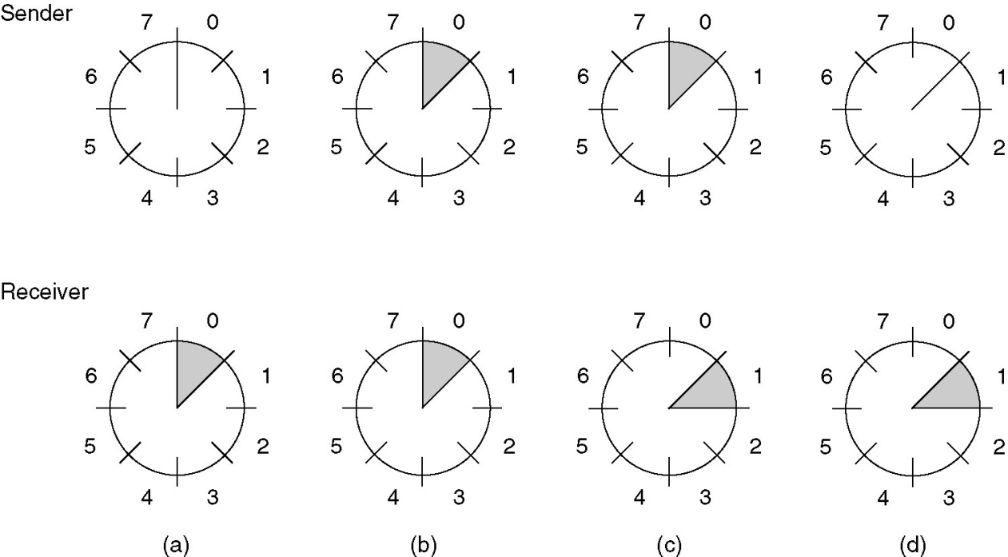
Sliding Window Protocols
A sliding window of size 1, with a 3-bit sequence number
(a) Initially.
(b) After the first frame has been sent.
(c) After the first frame has been received.
(d) After the first acknowledgement has been received.

Slide 31
A Protocol Using Go Back N
Receiver will only accept the next frame in the sequence.
Advantage: simple.
Disadvantage: Waste bandwidth if high error rate exists.

Slide 32
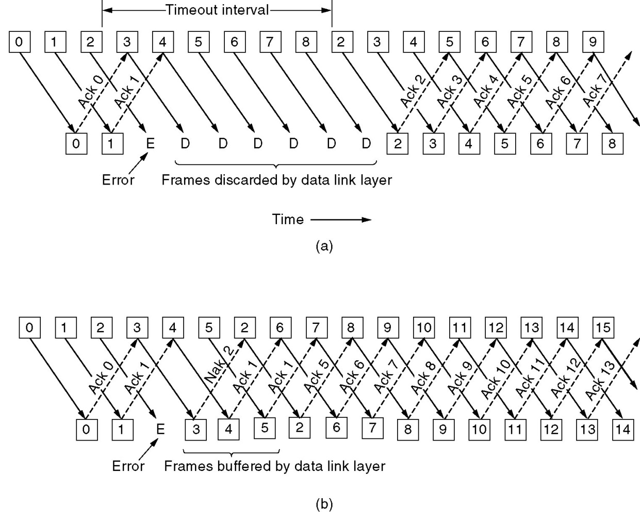
A Protocol Using Go Back N
Pipelining and error recovery. Effect on an error when
(a) Receiver’s window size is 1.
(b) Receiver’s window size is large.

Slide 33
A Sliding Window Protocol Using Selective Repeat
Receiver accepts any frame in its window, but only acknowledges the last frame in the successful sequence. The receiver can notify the sender to transmit a missing frame using the same two approaches:
  timeout
  receiving a special frame from receiver.
Advantage: don't waste bandwidth
Disadvantage: Receiver must buffer frames, thus imposing a higher memory requirement on the receiver.

Slide 34
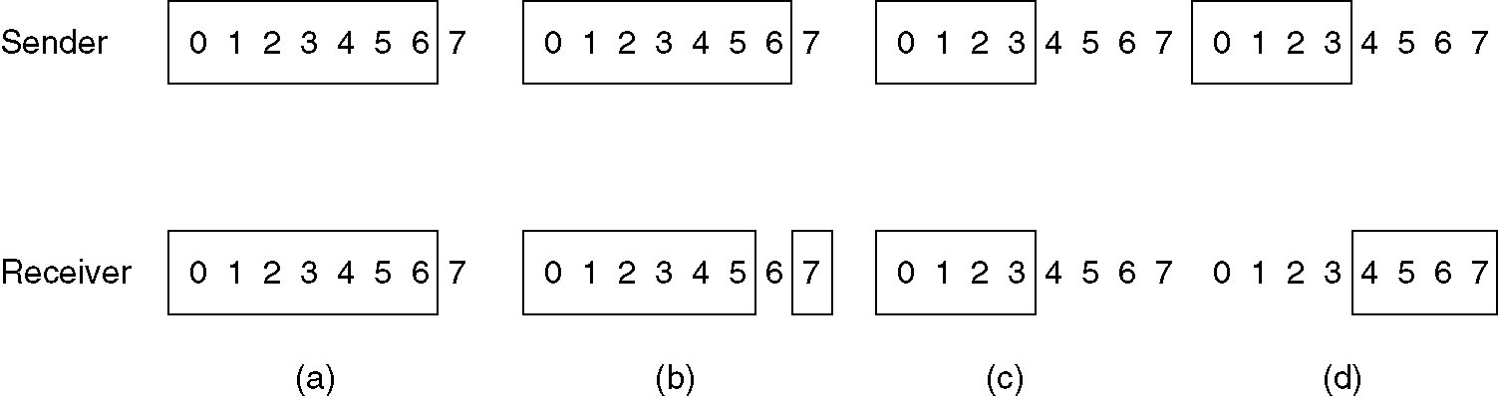
A Sliding Window Protocol Using Selective Repeat
(a) Initial situation with a window size seven.
(b) After seven frames sent and received, but not acknowledged.
(c) Initial situation with a window size of four.
(d) After four frames sent and received, but not acknowledged.

Slide 35
Protocol Verification
Much research has been done by trying to find formal, mathematical techniques for specifying and verifying protocols.
  Finite State Machined Models
  Petri Net Models

Slide 36
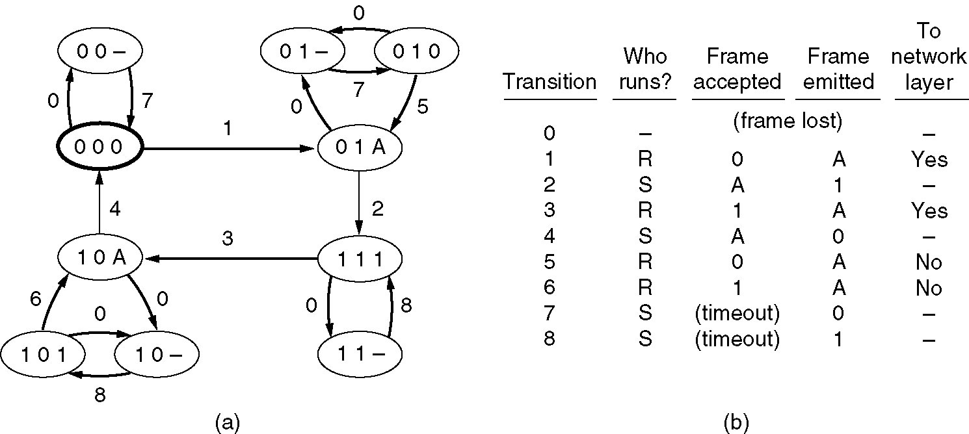
Finite State Machined Models
Given a complete description of the protocol machines and channel characteristics, it is possible to draw a directed graph showing all the states as nodes and all the transitions as directed arcs.
(a) State diagram for protocol 3. (b) Transitions.

Slide 37
Petri Net Models
A petri net has four basic elements: places, transitions, arcs, and tokens.
A place represents a state which the system may be in.
A transition is indicated by a horizontal or vertical bar.
Each transition has zero or more input arcs coming from its input places, and zero or more output arcs, going to its output places.
A transition is enabled if there is at least one input token in each of its input places.
Any enabled transition may fire at will, moving the token from an input place to an output place.

Slide 38
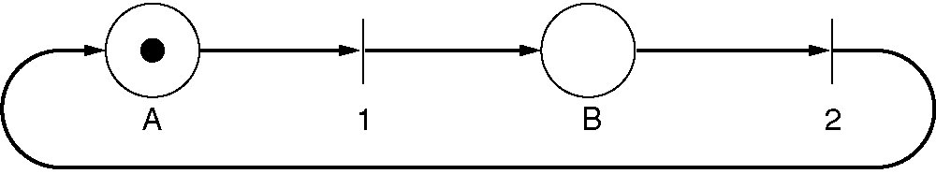
Petri Net Models
A Petri net with two places and two transitions.

Slide 39
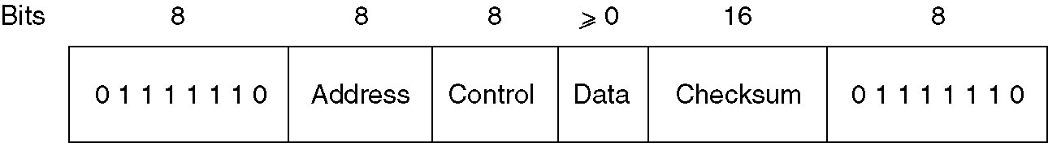
High-Level Data Link Control (HDLC)
Frame format for bit-oriented protocols.
  Flag sequence: 01111110
  Address: identify one of terminals or distinguish commands from responses
  Control: sequence numbers, acknowledges, other purposes
  Data: any information
  Checksum: cyclic redundancy code

Slide 40
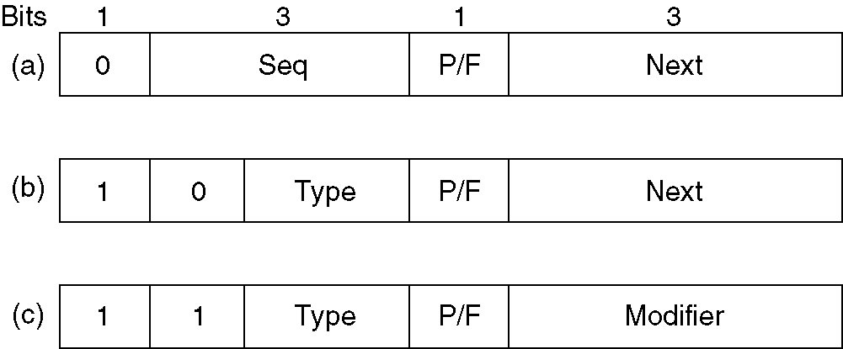
High-Level Data Link Control
Control field of
(a) An information frame.
(b) A supervisory frame.
(c) An unnumbered frame.

Slide 41
Control Field of HDLC
Fields in an information frame:
  The Seq field is the frame sequence number.
  The Next field is a piggybacked acknowledgement.
  The P/F bit stands for Poll/Final. It used when a computer is polling a group of terminals.
    P: the computer is inviting the terminal to send data.
    The final one is set to F.
The type field in a supervisory frame:
  Type 0: acknowledge frame
  Type 1: negative acknowledge frame
  Type 2: RECEIVE NOT READY
  Type 3: SELECTIVE REJECT

Slide 42
High-Level Data Link Control
The unnumbered frame is used for control purposes but can carry data in unreliable connectionless service.
Commands:
  DISC (DISCconnet) allows a machine to announce that it is going down.
  SNRM (Set Normal Response Mode)/ SABM (Set Asynchronous Balanced Mode) announce a machine has just come back on-line.
  FRMR (FRaMe Reject) indicates a frame with a correct checksum but impossible semantics.

Slide 43
The Data Link Layer in the Internet
Point-to-point communication:
  Router-router leased line connection
  Dial-up host-router connection
PPP provides three features:
  A framing method to delineate the frame and handle error detection
  LCP (Link Control Protocol) for brining lines up, testing them, negotiating options, and brining down them down.
  A way to negotiate network-layer options or have a different NCP (Network Control Protocol).

Slide 44
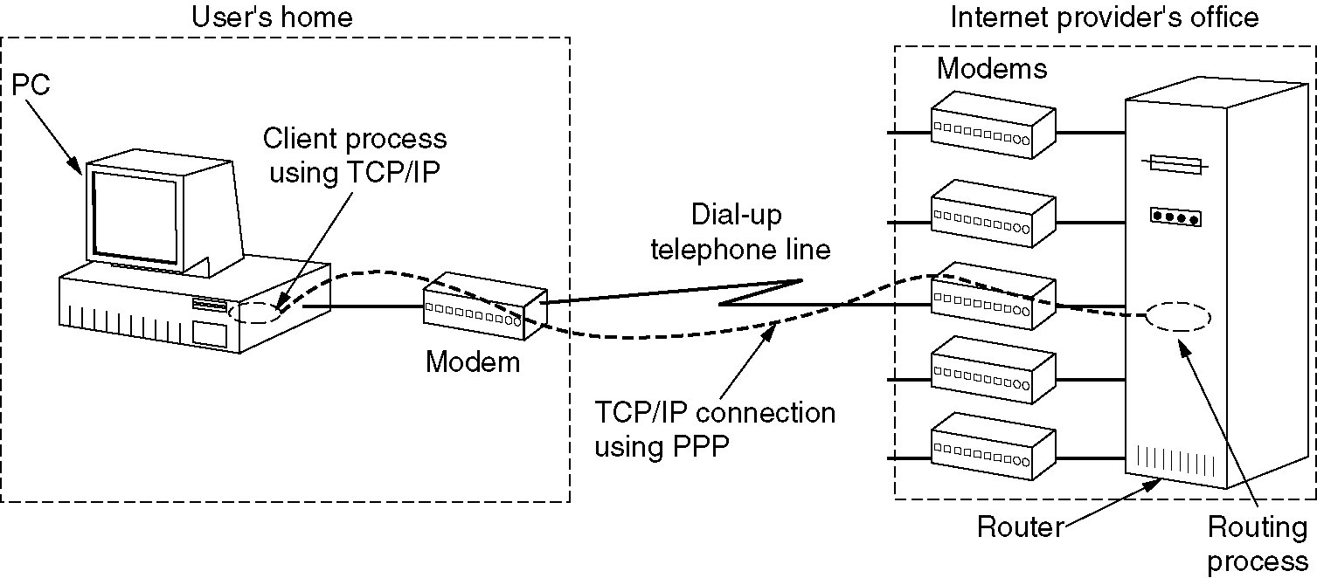
The Data Link Layer in the Internet
A home personal computer acting as an internet host.

Slide 45
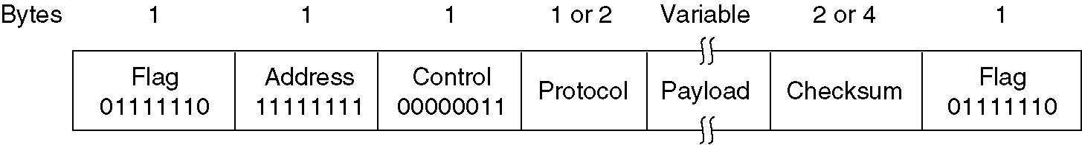
PPP – Point to Point Protocol
The PPP full frame format for unnumbered mode operation.
  Flag byte: 01111110
  Address: 11111111 indicates all stations to accept the frame
  Control: default value, 00000011 for an unnumbered frame (unreliable transmission)
  Protocol: indicate what kind of packet is in the payload
  Payload: data (default length: 1500 bytes)
  checksum

Slide 46
PPP Protocol
PPP is a multi-protocol framing mechanism suitable for use over modems, HDLC bit-serial lines, SONET, and other physical layers.
PPP supports error detection, option negotiation, header compression, and reliable transmission.
LCP is used to negotiate data link protocol options.

Slide 47
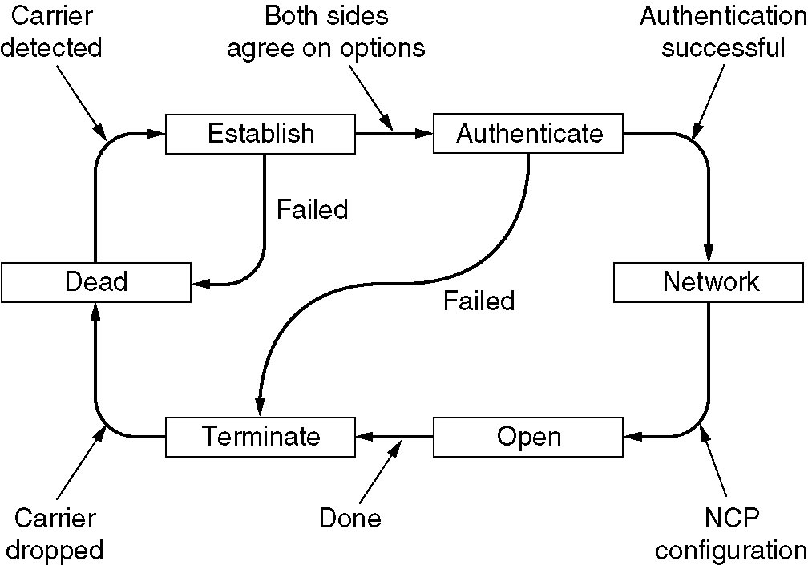
PPP – Point to Point Protocol
A simplified phase diagram for bring a line up and down.

